Slide 1
Continent
By : Shannonsalim

Slide 2
What is continent ?
Continent is a huge part of landmass . Continent live a long time . But long ago continent joined together and it look like finished puzzle and called Pangaea , The continent move every year but they move tiny centimeters . The 7 continents are Antarctica, South America , North America , Europe , Africa, Australia, Asia .

Slide 3
Question & answer
Do all of the continent join together ? How ?
Yes they all joined together long time ago .because long ago oceans wave are big so the wave kept pushing and pushing so it kept getting closer and closer and connect .
How do they spilt apart ?
they spilt apart because of the ocean wave pushing , living things , human and natural disaster .
Why do land become smaller and smaller ?
it is because the sea level rise up and cover the land so area of the land become smaller.

Slide 4
factors that make Pangaea spilt up
Natural Disaster
Waves
Human
Living things
Earth itself

Slide 5
Before Pangaea split up
Before Pangaea spilt all continent is join together , We do not need to have a device , phone , telephone and transportation to contact and to meet our family , friends and cousin, but along time ago people don’t have something special , all of the things are all the same .So long time ago it is boring .

Slide 6
After Pangaea split up
After Pangaea split up every thing was change the environment was more modern and we need transportation to travel from place to place . Continents are spilt up and it look alike to a unfinished puzzle . Animals , culture , food , traditions , transportations and digital medias is all different in each continent . Also now it is really fun cause human can learn in school , be smart and last they can create fun thing for us !!!

Slide 7
How human respond to changes to the environment
The changes from Pangaea to continents:
Along time ago people have short distance to go to another continent .
Now people need a airplane or a ship to travel because of the continent split up
The changes of the continents:
Ice are melting in North and South Poles and if it melt the water is formed and become a wave and sometimes it can make continent drown people move to another continent
Pollution it can make flood and flood can make big waves , then big waves can make 1 of the continent drown 1 day so human try to stop polluted on the earth.

Slide 8
Bibliography
www.makemegenius.com
www.kidsgeo.com
www.kidsbritannica.com
www.brintannica.com
http://www.sheppardsoftware.com/World_Continents.htm
http://lizardpoint.com/geography/world-quiz.php
http://thekidshouldseethis.com/post/75612701935

Slide 9
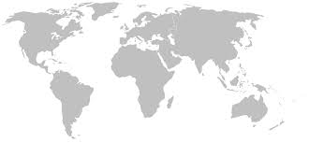
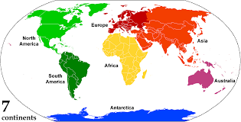
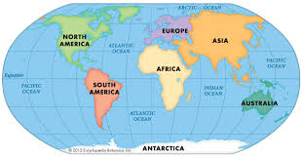
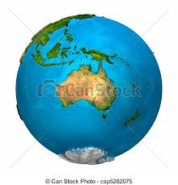
pictures
E
A
R
T
H
&
C
O
N
T
I
N
E
N
T

