Slide 1
Note Taking

Slide 2
Seeing + Listening = Observation

Slide 3
Remembering Note Taking

Slide 4
Note-taking Techniques you need to know: Venn Diagrams Bullet pointing, Making Key Word lists, Making Flowcharts

Slide 5
Venn Diagrams make comparisons easy

Slide 6
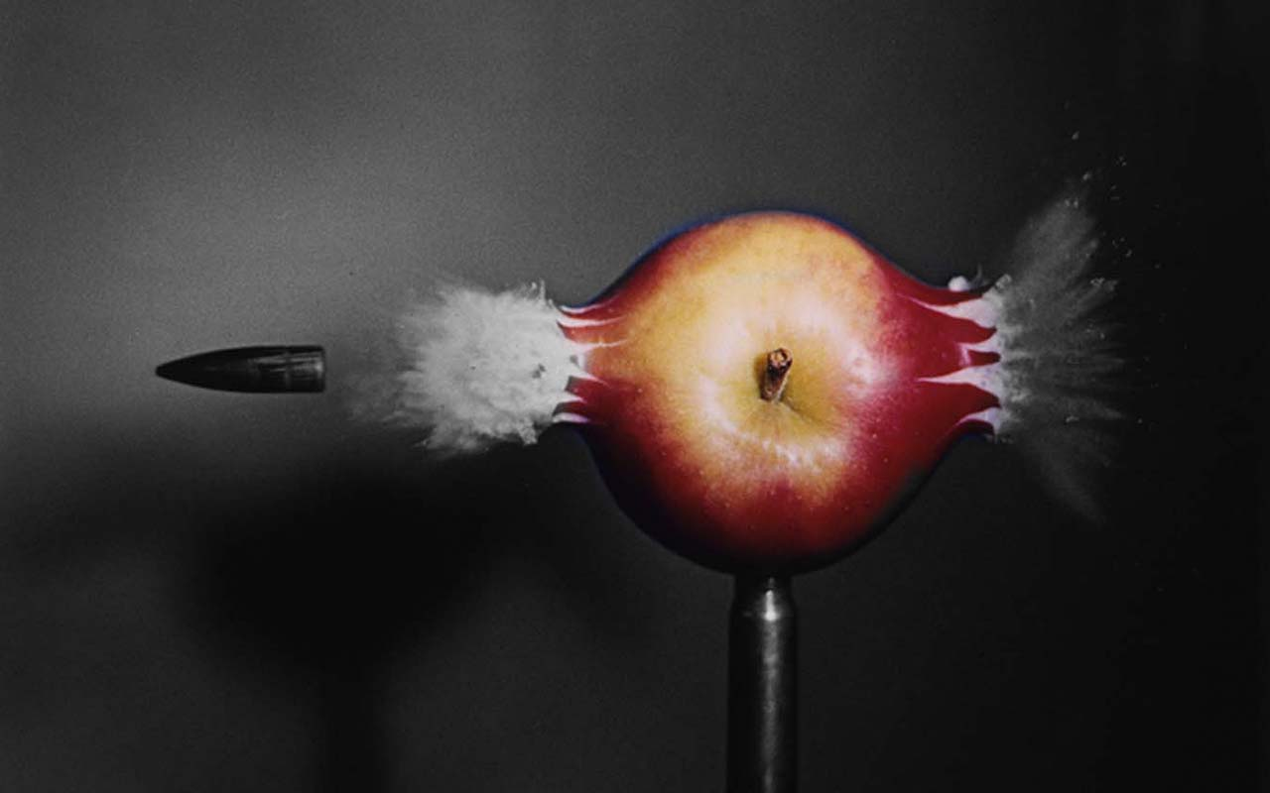
Bullet Points

Slide 7
Not Just a List
Idea 1
Idea 2
Thing to remember
Thing to remember
Thing to remember
Thing to remember
Thing to remember
Thing to remember

Slide 8
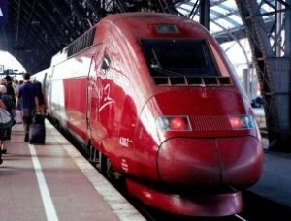
Watch the video
Make a bullet point list of two ideas and 3 things to remember about each idea
..\Videos\▶ How to Travel Through Europe by Train Video - About.com.mp4
Travelling by train
Tickets

Slide 9
Flowcharts

Slide 10
We use flow chart to record a process
Make a flowchart of the process of brushing your teeth
Make a flowchart of the process of doing up your seat belt
OR

Slide 11
List of Key words
I heard:
names of people and places
dates
new vocabulary
I saw:
Signs
information or instructions
new words
names of people and places

Slide 12
How confident are you?
Using Venn diagrams to compare
Using Bullet points
Making key word lists
Using flowcharts
My skills as a note taker:
0 need lots of practice 5 I feel ready 10

