Slide 1
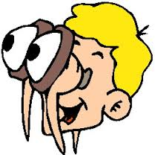
Observation
PYP 1
Information Literacy

Slide 2
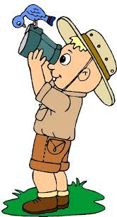
What?
Is the process of watching someone or something
Puts attention on the details
Describes objects
Explains activities

Slide 3
Process
Watch
Find out the routines
Describe the activities
Who are involved

Slide 4
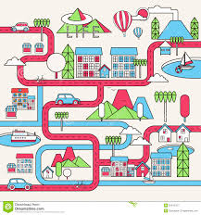
Observing Public Place What you need to find?
Running hours
Procedures
Facilities

