Slide 1
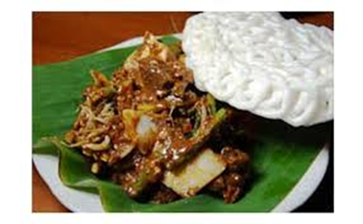
Patrick 2c 23.11.2015
Indonesian traditional food
Ms. evy

Slide 2
Rujak cingur
Made from fruits and vegetables. Usually add with krupuk and it has spicy flavour.
We can find this food in east java, specially in surabaya.
We serve it in banana leave or in a plate.
People like it because its very tasty.

Slide 3
Indonesian instrument : angklung
Indonesian food : rujak cingur
Indonesian house : joglo
Indonesian clothes : batik

